Slide 1
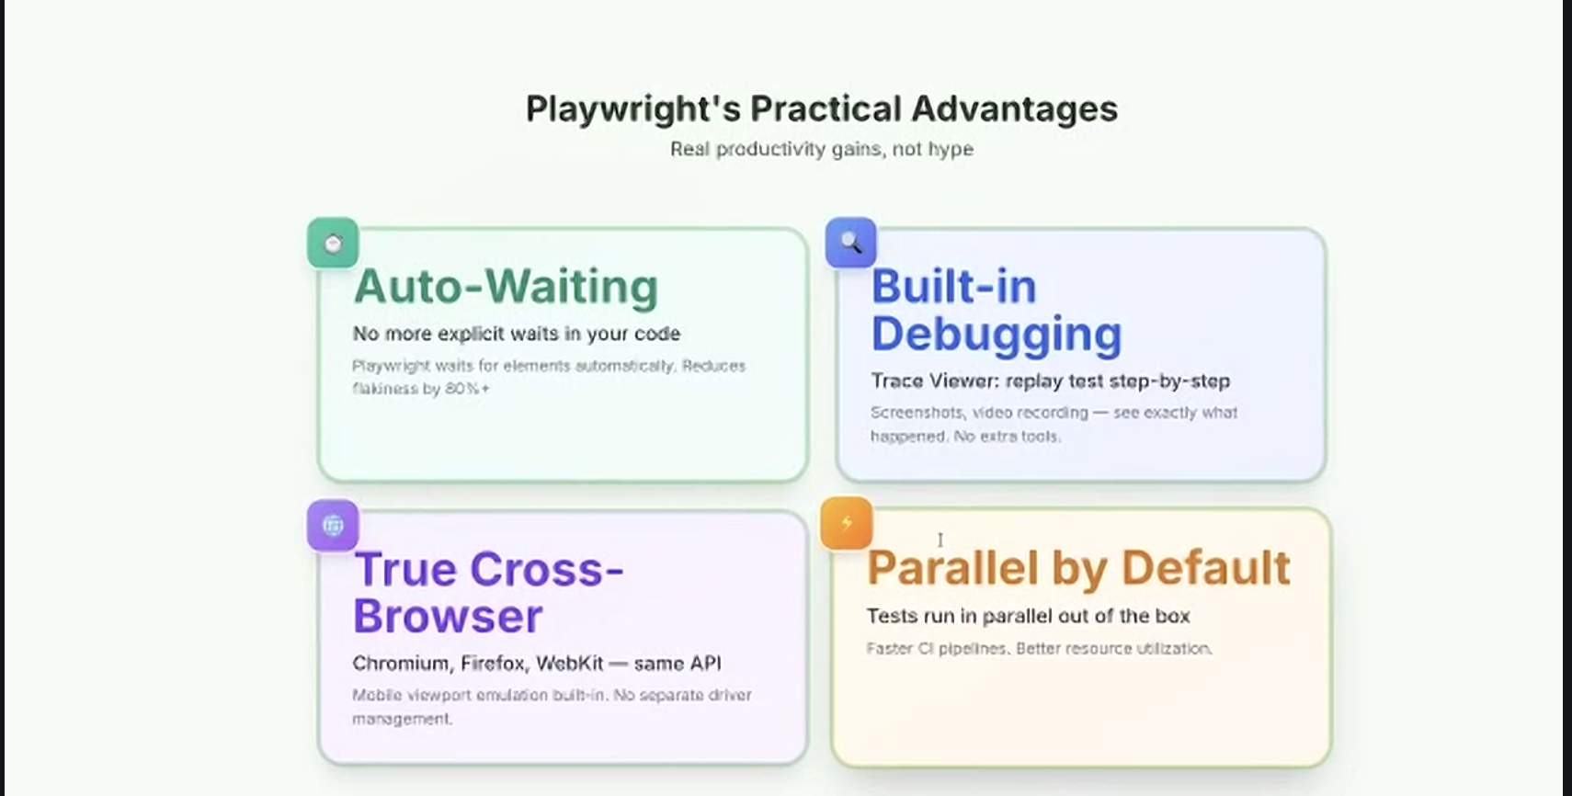

Slide 2
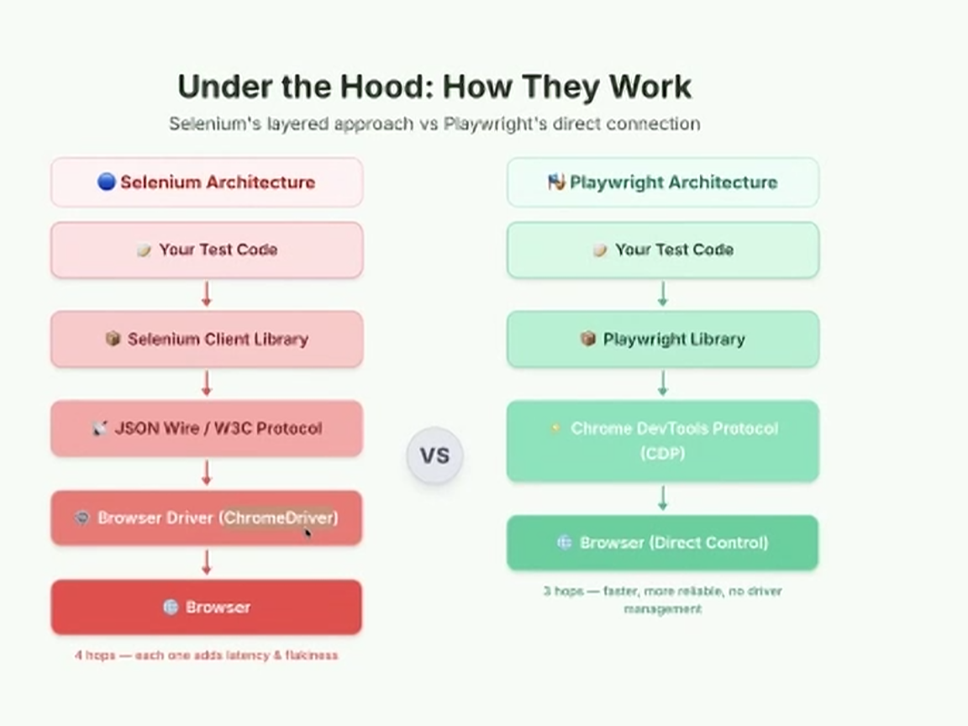

Slide 3
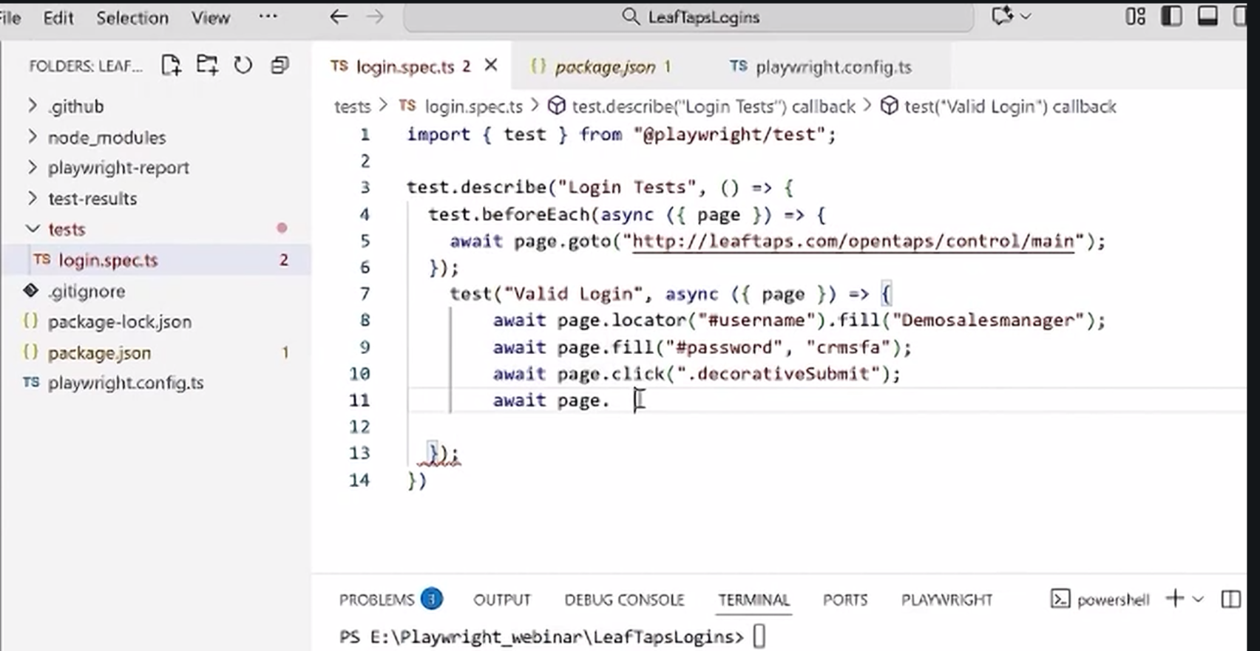
Language – Typescript AI: Typescript/ Python
Diffb/n Type script and Java
95% same
Typescript has strict data type declaration
When compiled Typescript is java
Typescript is superset of java
Java is a synchronous language – waits for things to complete
Java Script needs to specifically mention wait
Typescript has await statement

Slide 4
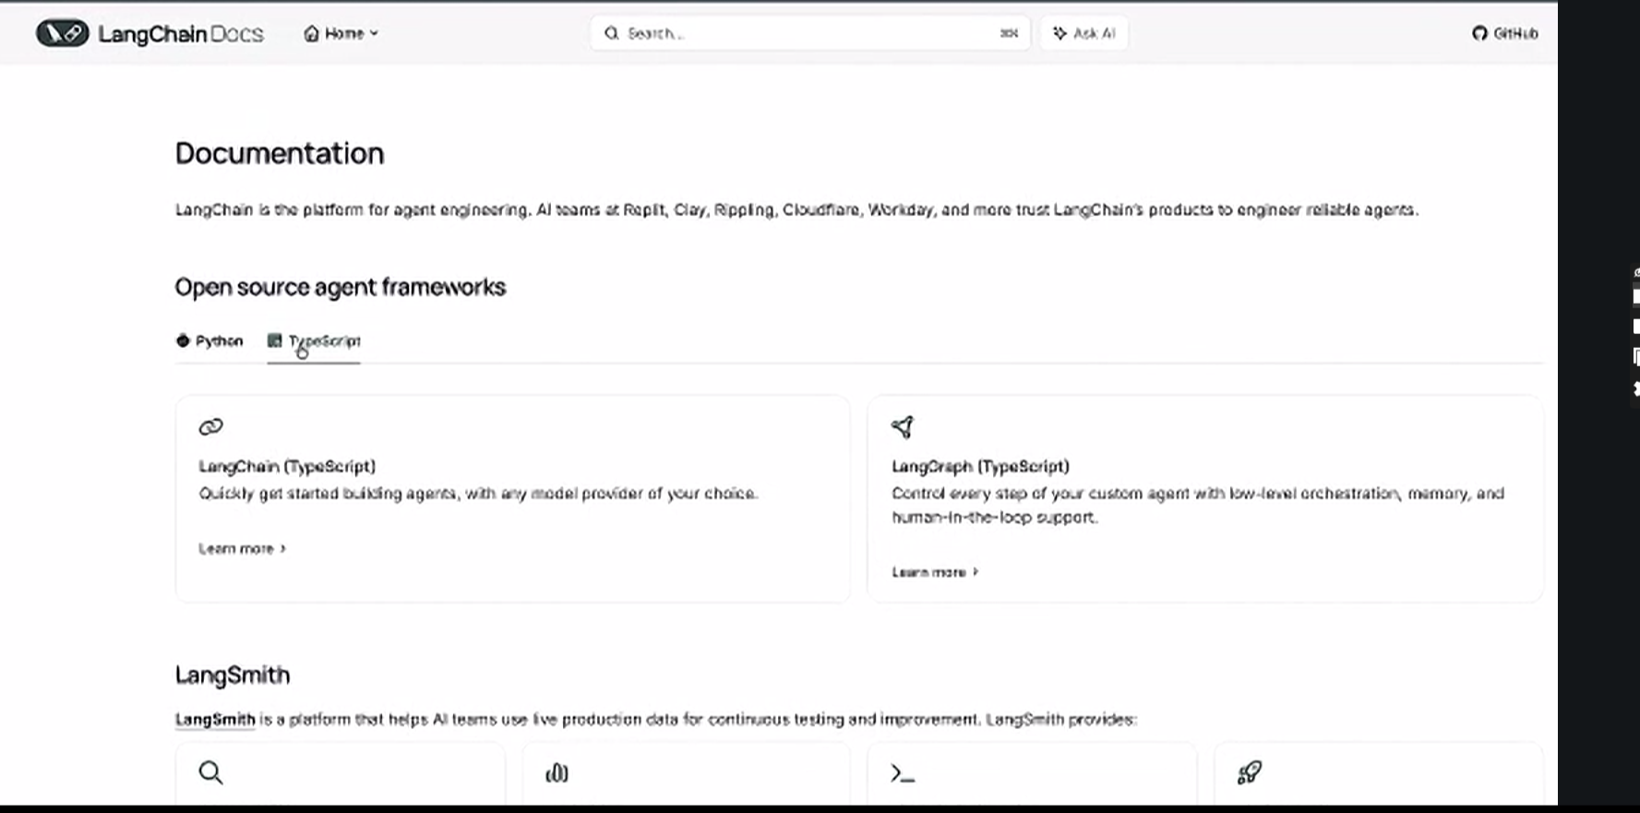

Slide 5
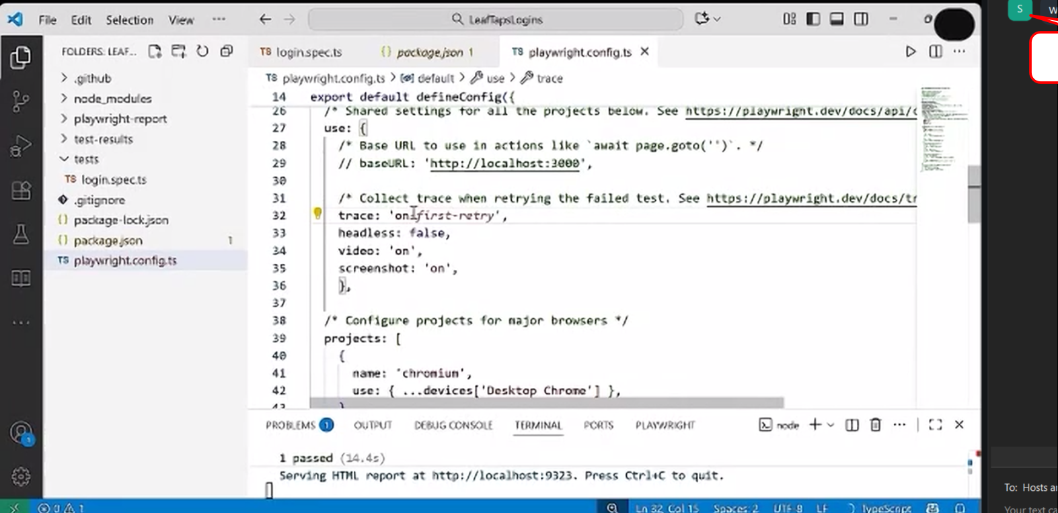
Configure…it will take screenshot or video automatic

Slide 6
Raise issues in JIRA automatically
Traceviewer can capture all API calls
Can test on multiple browser at same time

Slide 7
Framework feature
Should work in multiple test environment
Useful reporting
POM

Slide 8
Code word
LOCUS
TRACE
ASCEND

